Slide 1
Bio-Waste Management System

Slide 2
About KEIL
Kerala Enviro Infrastructure Ltd (KEIL) is a public limited Company functioning at the industrial hub of Ambalamedu, situated about 25 KM on the Eastern side of Kochi City. This facility was established on the directive of the Supreme Court Monitoring Committee on hazardous waste for treatment and disposal of hazardous waste generated from industries in the State of Kerala. Govt. of Kerala appointed Kerala State Industrial Development Corporation (KSIDC) as nodal agency for setting up a Common Hazardous Waste Treatment, Storage and Disposal Facility (CHWTSDF) for management of hazardous waste in the State of Kerala. KSIDC established KEIL as a Special Purpose Vehicle with participation of 85 industries in the State. M/s United Phosphorus Ltd (now UPL Limited) was appointed as Developers for the project. UPL Limited and its group companies with a contribution of Rs. 6.51 crores, has the majority equity in the Company.
The common TSDF was setup and operated as per the norms and guidelines laid down by the Ministry of Environment, Forest and Climate Change, Government of India and Central Pollution Control Board / Kerala State Pollution Control Board.

Slide 3
KEIL Requirement and Challenges
KEIL was looking for software to manage the BIO WASTE as per CBCP (Central Pollution Control Boards) guidelines
Application aims to handle the tracking of inventory of the garbage bags in KEIL side, waste movement tracking from HCF (Health Care Facility) to KEIL waste management facility.
Centralized system which can be integrated GPS for tracking of the garbage trucks, barcode hardwares and consumables
Challenges Faced
To understand and develop system as per CPCB gudlines
Ontime GPS tracking integration to web based application.
Create single mobile/android application for working in diffrent android version
Getting bags weight from weighing machine to android Mobiles/Scanners

Slide 4
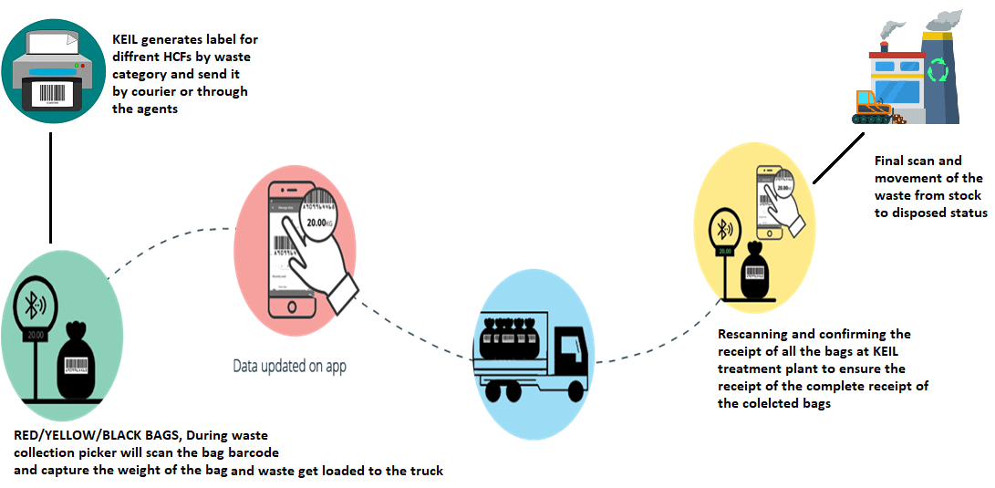
Solutions Overview

Slide 5
Main Transactions
1.Barcode Generation
Using this option user can generate barcodes labels against each hospital. User will select waste bag colour with quantity and once all details added after submission barcode labels will generate as per the quantity and below given format.
Sample of barcode label given below:
Colour name in text inside a box - It indicates the colour of the bag
Seq No.- Unique sequence number generated from the software
Barcode – Customer Code,6 digit pin code, State code, Type of HCF, Affiliation number of the HCF, Unique sequence number

Slide 6
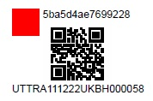
Barcode as per CPCB guidelines
Pre Printed label details
Bar-Code Sequence No
7mm X 7mm
Color Coding
6 digit
Unique Sr. No. of HCF
1st five digit of Name of HCF
2 digit
Type of HCF
6 digit Pincode
2 digit
State Code

Slide 7
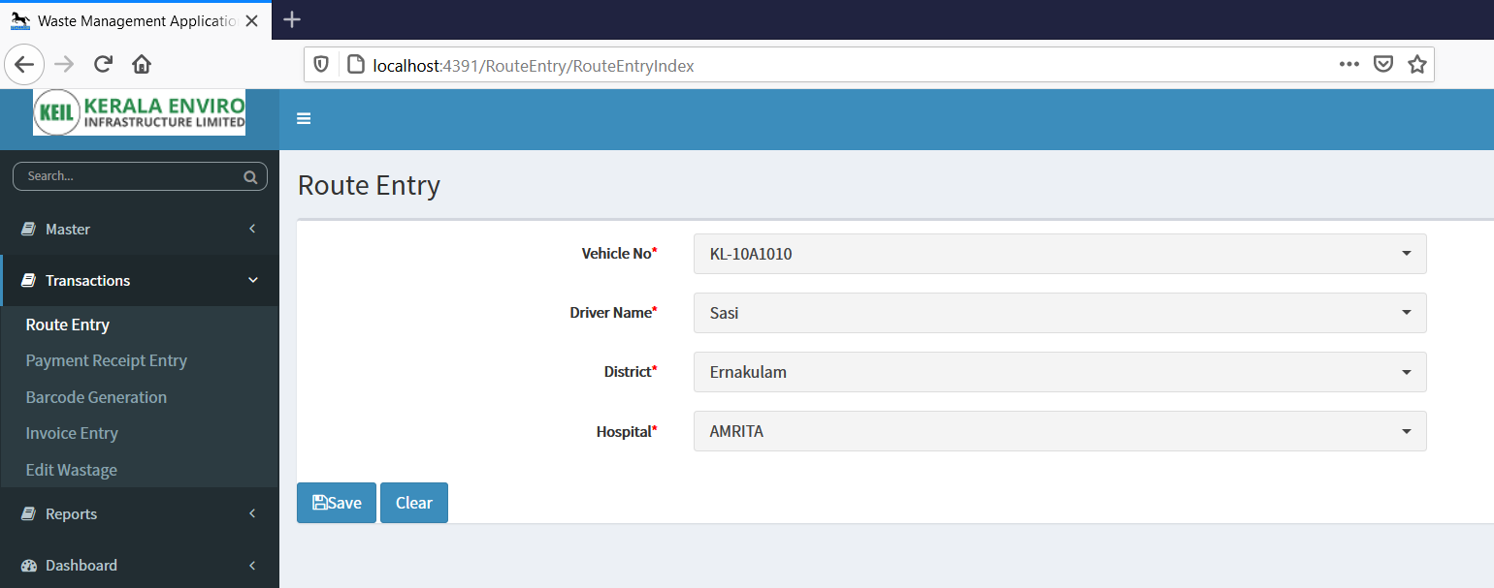
2.Route Entry
Using this option in web user can enter collection destinations in advance or in absence of a collection agent in a day by selecting the vehicle and driver and selecting the hospital.
Blue print screen

Slide 8
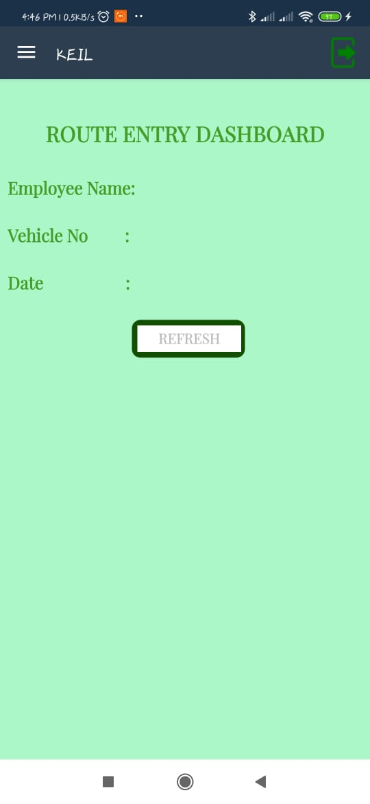
3.Route Entry Dashboard
Using this option in mobile/Scanner, logged user can know the pending or completed route details from this screen

Slide 9
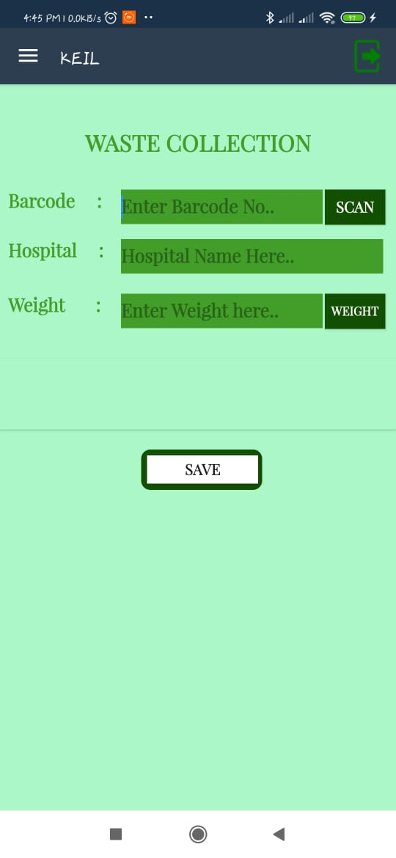
4.Waste Collection Scanning
Using this option in mobile/Scanner, user can scan the barcode in the bag and will capture weight from the weighing machine using Bluetooth or can enter manually, user will get bag colour indication in the application screen after scanning the bag for verification. Data will save to online server with GPS Details against logged user.

Slide 10
5.Waste Receipt Scanning at KEIL
Once waste bag received at the KEIL using this option in HHT user will scan the barcode and will capture the weight from the weighting machine or can enter manually, user will get bag colour indication in the application screen after scanning the bag for verification.

Slide 11
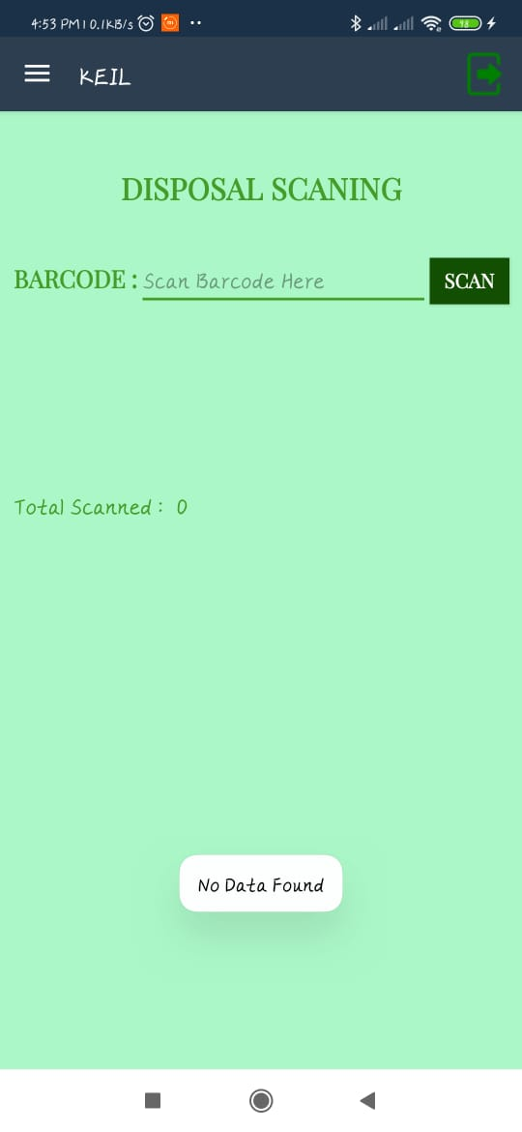
6.Disposal Scanning at KEIL
Received bags will scan before disposal at the KEIL using this option with HHT. User will scan the barcode. Data will save to online server with below details.

Slide 12
7.Vehicle Dashboard
Live tracking of wastage collection with GPS against each vehicle.

Slide 13
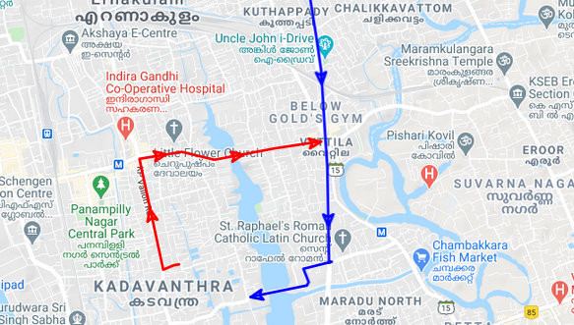
User can also show the route maps against each vehicles when clicking View Detail Map button on above screen. The map blue prit screen is below.

Slide 14
Result
The solution given by Stallion given start to end traceability of the waste collected from HCF, Receipt and waster treatment center till disposal
Automated report generation for daily collection and filing to CPCB become and easy process
They were having strict rules for keeping the collected waste bags it was actually not following properly before. But as our software implemented there, the process is going smoothly.
Alerts from system to concern team over email in case of over due in disposal based on waste category
Monitoring of the truck movement from central office

Slide 15
Solution Portfolio
Stallion Bio waste management software
Android mobile devices
Barcode Printer
Labels And Ribbon
Weighing Machine
GPS Devices

Slide 16
Thank You
THANK Y
For your wathcing

